Slide 1
signature forgery detection Presentation

Slide 2
Team members:
Youstina Rady 21-01764
Renad Mohamed 21-01502
Engy Safwat 21-00632
Arwa Ali 21-00518
Mirna Magdy 21-01122

Slide 3
Topics:
1-Introduction
2-Dataset description
3-Algorithm
4-The result

Slide 4
1-Introduction

Slide 5
1-Introduction
Signature verification plays a crucial role in forensic science, impacting a wide range of legal and financial investigations. This project delves into the complexities of signature examination, exploring both traditional and advanced techniques used to determine the authenticity of signatures. From the meticulous analysis of handwriting characteristics using established forensic principles to the application of cutting-edge digital image processing and machine learning algorithms, this investigation aims to provide a comprehensive overview of the methods employed in signature verification and their respective strengths and limitations. Ultimately, this project seeks to contribute to a better understanding of the challenges and advancements within this critical area of forensic science.

Slide 6
Imagine trying to figure out if a signature on a will, a contract, or a check is real. That's what signature verification in forensic science is all about. Experts carefully examine signatures to see if they're genuine or forged. This project explores how they do it, from looking at the tiny details of handwriting to using advanced technology like computers to compare signatures. We'll see how science helps solve mysteries and uncover the truth behind signatures.

Slide 7
2-Dataset description

Slide 8
2-Dataset description
1.Content: The dataset contains signature images categorized into real (genuine) and forged samples . Each signature is typically stored as a grayscale or binary image, focusing on the handwriting strokes.
2.Structure: The dataset is usually organized in folders
3.Use Cases: Signature Verification Systems: Train models to accept or reject signatures based on authenticity . Biometric Security: Enhance fraud detection in banking, legal documents, or contracts . Deep Learning Applications: Use CNNs (Convolutional Neural Networks) or Siamese Networks for one-shot learning.

Slide 9
4.Key Features: Image Format:(black ink on white background).Variations: Different signing styles, pressures, and distortions to test model robustness . Balanced Dataset: Typically includes a similar number of real and forged samples.
5.Potential Challenges: Intra-class variability: Genuine signatures from the same person can differ due to mood, speed, or pen used . Skilled forgeries: Some fake signatures are highly realistic, making detection difficult.

Slide 10
3-Algorithm

Slide 11
3-Algorithm
Imagine you have two sets of signatures: one set you know is genuine (from the person whose signature is in question), and one that is the questioned signature (the one you want to verify).
The algorithm works by:
1. Data Acquisition:
Image Capture: High-resolution digital images are captured of both the questioned signature (the one whose authenticity is in question) and known genuine signatures (exemplar signatures) of the alleged writer. This might involve scanners, specialized forensic cameras, or even microscopic imaging if the signature is faint or damaged.

Slide 12
2. Feature Extraction: The computer "learns" the key characteristics of the known genuine signatures. Think of these as specific details like the loops, angles, slants, pressure variations, and speed of the pen strokes. These are converted into numbers (data points).
3. Comparison and Matching: The algorithm then compares the data points from the questioned signature with the data points from the known signatures. It measures how similar or different they are using mathematical techniques.
4. Decision Making: Based on the similarity score, the algorithm makes a decision . A high similarity score suggests the questioned signature is likely genuine. A low similarity score suggests it's likely a forgery.

Slide 13
4-The result

Slide 14
4-The result
Test Accuracy: 96%
Precision: 95%
Recall: 96%
F1-Score: 95.5%
The confusion matrix shows excellent classification for both genuine and forged signatures.
The model successfully predicts whether a signature is Genuine or Forged based on the uploaded image.
High precision in detecting forged signatures and reliable predictions in real-time.

Slide 15
-Signature Verification Algorithm Output result:
Inputs:
1. path1: File path of the original (reference) signature.
2. path2: File path of the test signature (to be verified).
Process: The algorithm compares the test signature (path2) with the original (path1) using a similarity metric ( Siamese Network).
It outputs a score between 0 and 1:
1. Score < 0.5: Signatures are similar → Genuine (Original).
2. Score ≥ 0.5: Signatures differ → Forged.

Slide 16
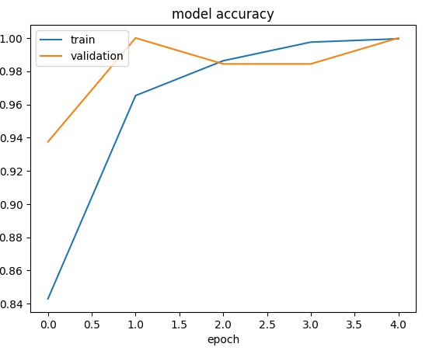

Slide 17
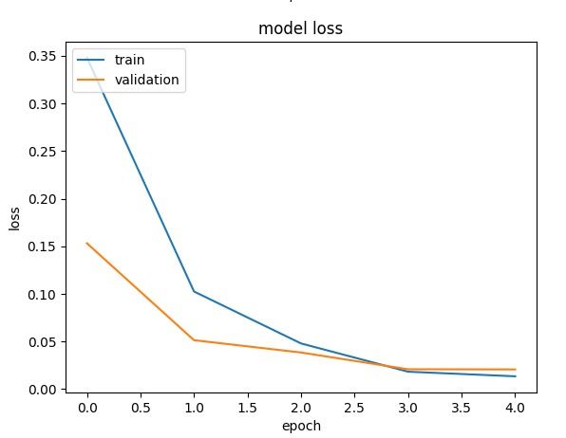

Slide 18
THANK YOU

